Slide 2
Develop a Smart Attendance Capturing Mobile App
Submitted to:
Department of Computer Science and Engineering

Slide 3
Supervised by: Prof.
1. Shubham Patel
2. Sarvesh Lowanshi
3. Shivam Chouhan
4. Vikas Rawat

Slide 4
Project Presentation Outline
Abstract
Introduction
Problem Statement
Survey of Existing Systems
Project Objectives
Requirement Analysis
Designs/UML Diagrams
Solution Proposed
The Outcome Discussion
Conclusions and Limitations

Slide 5
Abstract
Employee attendance tracking is a vital issue in order to monitor employee’ performance in the company as well as in their way of working their performance. It becomes a key concern because the company authority maintains a rule that one employee can only work in company if his/her attendance is higher or equal to several percentage otherwise not. The traditional attendance system needs employee’s to physically sign the attendance sheet each time for the attendance of each shift. This is unnecessarily time-consuming to notice and mark employee name on the attendance sheet.

Slide 6
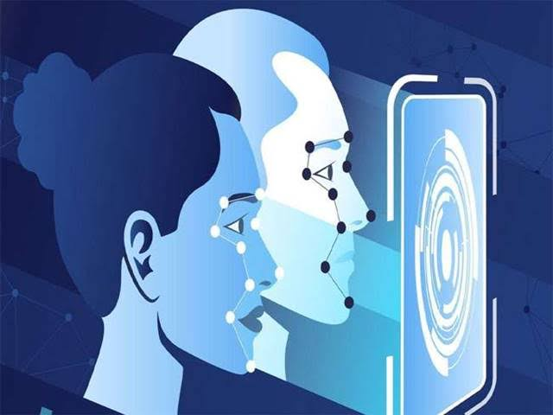
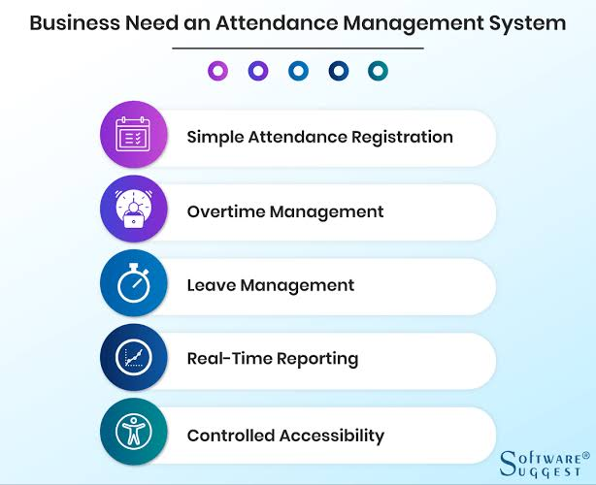

Slide 7
Introduction
Organizations of all sizes use time and attendance systems to record when employees start and stop work, and the department where the work is performed. However, it's also common to track meals and breaks, the type of work performed, and the number of items produced. In addition to tracking when employees work, organizations also need to keep tabs on when employees are not working Vacation time, compensation time, Family and Medical Leave Act (FMLA) time, and jury duty must be recorded. Some organizations also keep detailed records of attendance issues such as who calls in sick and who comes in late.

Slide 8
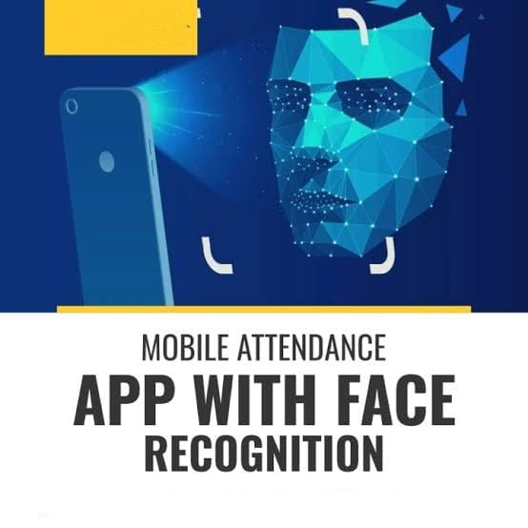

Slide 9
The Problem Statement
Niger Insurance PLC makes use of a pen and notebook to check attendance of its employees With this system, employees write their names, time of arrival and signature in ruled columns in the notebook. This data is used to process the salary of employees given account of times when they were late and absent. The issue with this system is that employees tend to falsify entries and indirectly

Slide 10
Survey of Existing Systems
1 Fingerprint Based recognition system:
In the Fingerprint based existing attendance system, a portable fingerprint device need to be configured with
the students fingerprint earlier. Later either during the lecture hours or before, the student needs to record the
fingerprint on the configured device to ensure their attendance for the day. The problem with this approach
is that during the lecture time it may distract of the students.

Slide 11
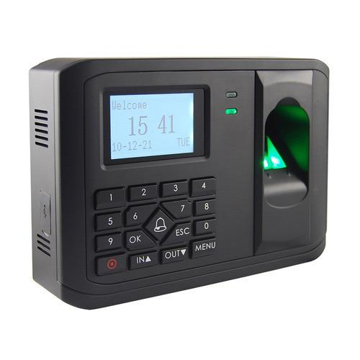

Slide 12
2. RFID (Radio Frequency Identification) Based recognition system:
In the RFID based existing system, the student needs to carry a Radio Frequency Identity Card with them and
place the ID on the card reader to record their presence for the day. The system is capable of to connect to RS232
and record the attendance to the saved database. There are possibilities for the fraudulent access may occur.
Some are students may make use of other students ID to ensure their presence when the particular student is
absent or they even try to misuse it sometimes.

Slide 13
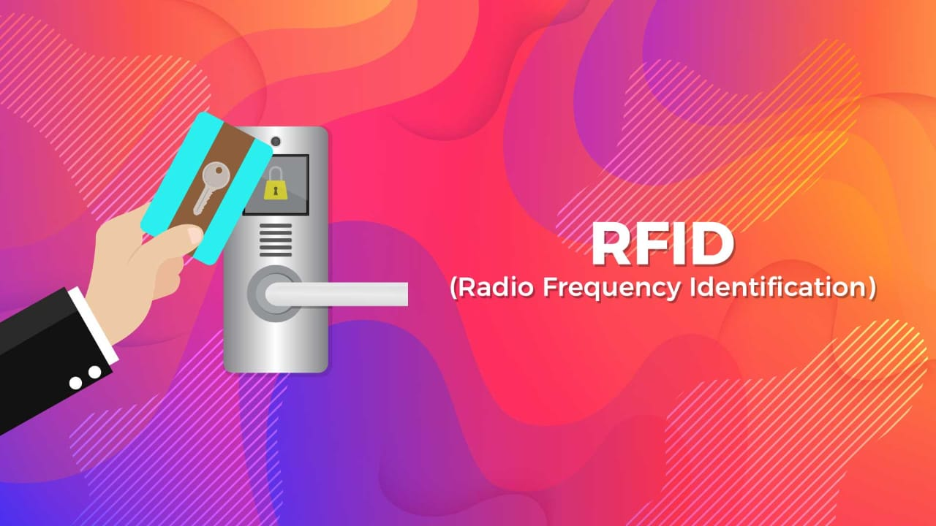

Slide 14
3. Iris Based Recognition System:
In the Iris based student attendance system, the student will scan the Iris of the student. Retinal scanning is
a different, ocular-based biometric technology that uses the unique patterns on a person's retina blood
vessels and is often confused with iris recognition.Iris recognition uses video camera technology with
subtle near infrared illumination to acquire V the detail-rich, intricate structures of the iris
which are visible externally. Digital templates encoded from these patterns by mathematical and
statistical algorithms allow the identification of an individual or someone pretending to be that
individual.[1] Databases of enrolled templates are searched by matcher engines at speeds measured in
the millions ofa different, ocular-based biometric technology that uses the unique patterns on a person's retina blood
templates per second per (singlecore) CPU, and with remarkably low false match
rates.needs to stand in front of a camera, so that the camera6. Project Description (200 words)
The process of the whole software system proposed, to be developed, should be mentioned in brief. This may be supported by Flowcharts/ER diagram to explain the flow of the information.

Slide 15
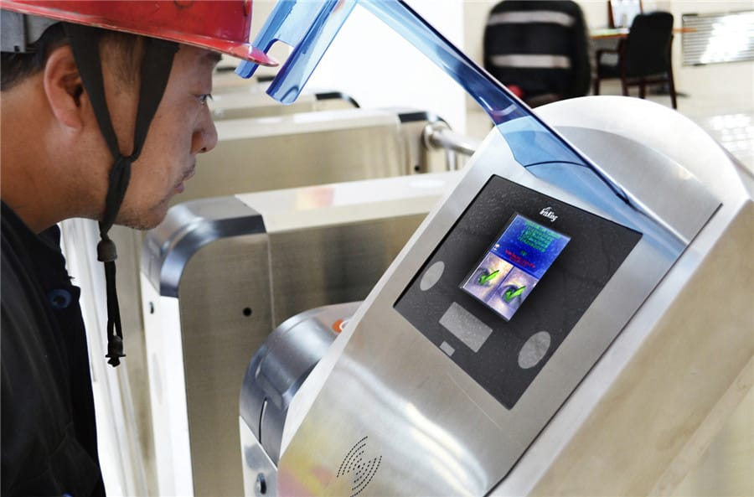

Slide 16
Face Based Recognition System:
The facial recognition technology can be used in recording the attendance through a high-resolution
digital camera that detects and recognizes the faces of the students and the machine compares the
recognized face with students’ face images stored inthe database. Once the face of the student is
matched with the stored image, then the attendance is marked in attendance database for further
calculation. If the captured image doesn't match with the students' face present in the database then
this image is stored as a new image onto the database. In this system, there are possibilities for
the camera to not to capture the image properly or it may miss some of the students from capturing.

Slide 17
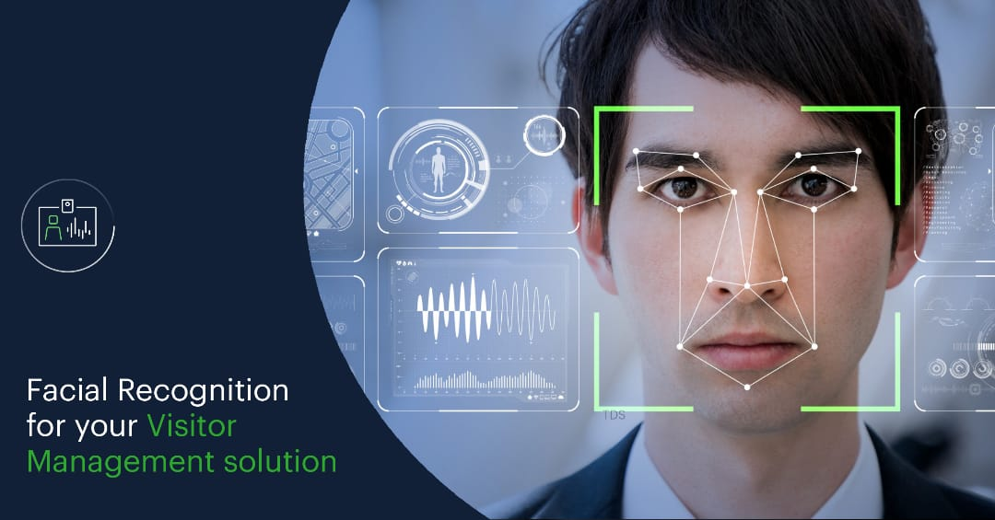

Slide 18
Objectives
Creating a database that contains attendance information of the employee
Linking this system to an existing employee management system
Capturing live feed from camera to record attendance times
Linking the information captured by the feed to the database for accuracy of results.

Slide 19
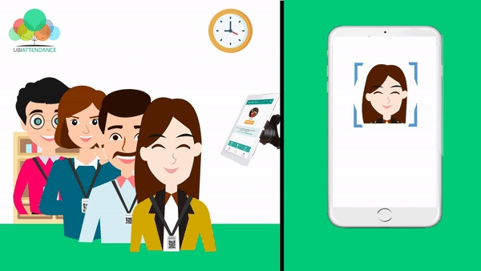

Slide 20
Requirement Analysis
Combines elements of the system planning and systems analysis phases of the Systems Development Life Cycle (SDLC), Users, managers, and IT staff members discuss and agree on business needs, project scope. Constraints, and system requirements. It ends when the team agrees on the key issues and obtains management authorization to continue

Slide 21
FUNCTIONAL REQUIREMENTS System must capture faces System must store faces in a DB attached to the employee’s ID
System must recognize the employee to enable attendance marking
NON-FUNCTIONAL REQUIREMENTS System shall be error-free
System shall operate in real-time System should prevent data manipulation System should have a maximum uptime

Slide 22
Solution Proposed
Our methodology we used to gather ideas To determine the best time and attendance systems , we started by listing all of the vendors that have a good reputation online ( i.e. , services that were favorably and consistently reviewed by other websites ) . Then , we interviewed small business owners to discover new ones to add to our list .
Next , we researched each provider by investigating its services , watching tutorials and how to videos , trying out the system when possible , and reading user comments . We also considered the pricing that was listed on these services ' websites . In all , we analyzed each service based on the following factors :

Slide 23
Cost
Time-tracting capabilities
Accrual options
Overall monitoring
Scheduling capabilities
Available reports
Ease of use
Customer service
Integration options
Mobile access

Slide 24
The Outcome Discussion
Mobile application will capture basic details of employees like Photograph (headshot), Name, Designation, Employee Number, Gender, Office Address, etc.
It should recognize the employee by face while capturing the attendance (entry) through face recognition and enter the relevant details including entry time in the system after successful face recognition. Similarly, while exiting the office premises, employee will be recognized using his/her face and exit time will be entered in the system.
The app should successfully work for any specific employees with or without wearing spectacles, cap or industrial helmet. This also notes down the time of arrival thus can acquire information about people coming in late after a specified time.

Slide 25
Conclusion and Limitation
Automated attendance systems are more efficient than manual systems as it prevents employees from falsifying entrientrie

Slide 26
Facial recognition access control has been on the market for the past 5 years, but there are major drawbacks to these systems that still leave many people concerned about the safety and security of using face recognition. The biggest limitations include lack of accuracy, spoofing issues, and difficult operating systems.
At Swiftlane, we have overcome these limitations, while creating the most advanced, touchless access control experience.
This article covers those limitations of face recognition access control and showcases how Swiftlane’s cutting edge technology is tackling many of these issues.

Slide 27
Acknowledgment

Slide 28
Q&A

Slide 29
THANKS

